Slide 1

Heart Disease Risk Analysis and Visualization using Python and Dash
DATS 6401 – Visualization of Complex Data
Name: Sagar Sanjay Shah
Instructor: Prof. Reza Jafari
G26436634

Slide 2
Introduction
The dataset is sourced from the CDC’s Behavioral Risk Factor Surveillance System (BRFSS), which conducts annual health-related surveys to assess the prevalence of chronic diseases and risk factors among U.S. adults.
This project aims to identify key lifestyle and demographic factors influencing heart disease risk through data visualization and build an interactive, deployable dashboard using Python and Google Cloud Platform.

Slide 3
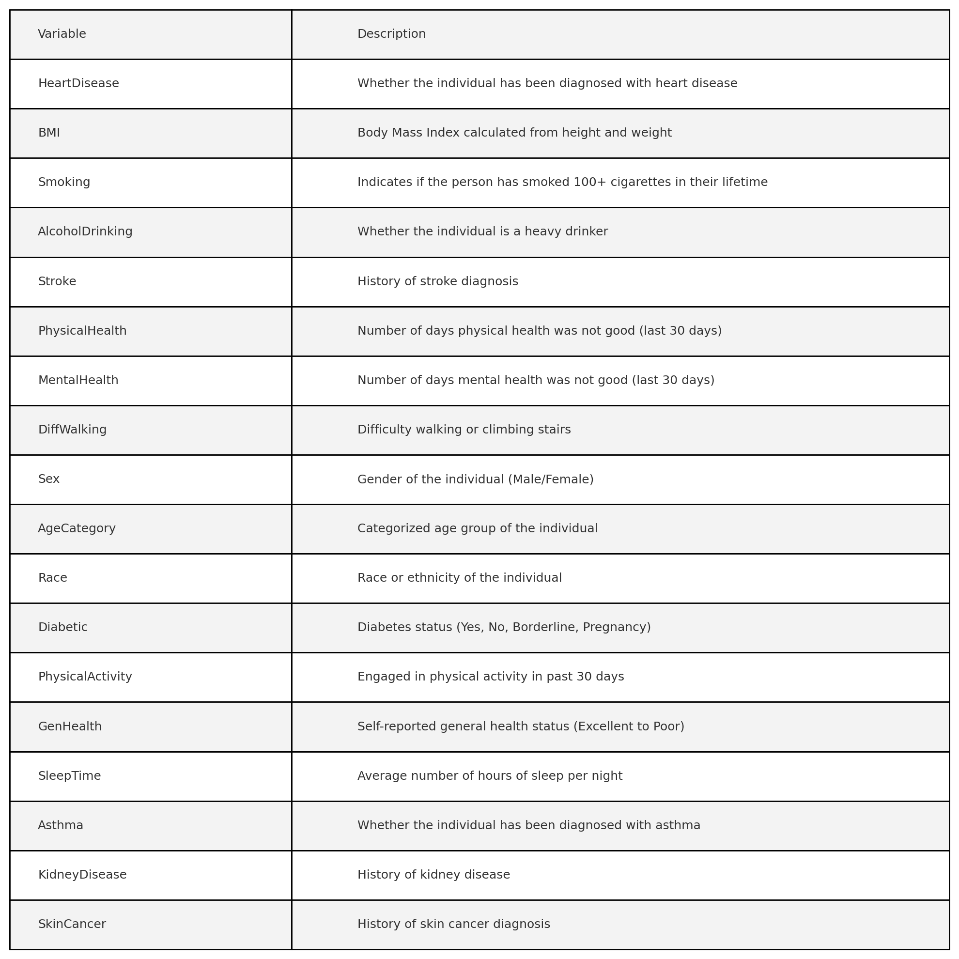
Variables
There are 18 variables (columns) in the dataset. Below are the selected and transformed variables used for visual and statistical analysis:

Slide 4
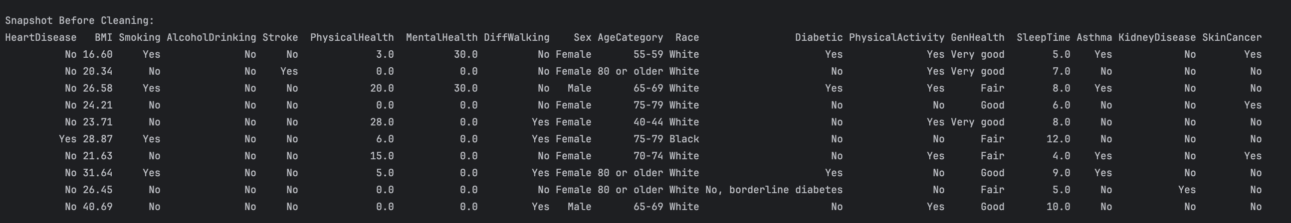
Before Cleaning

Slide 5
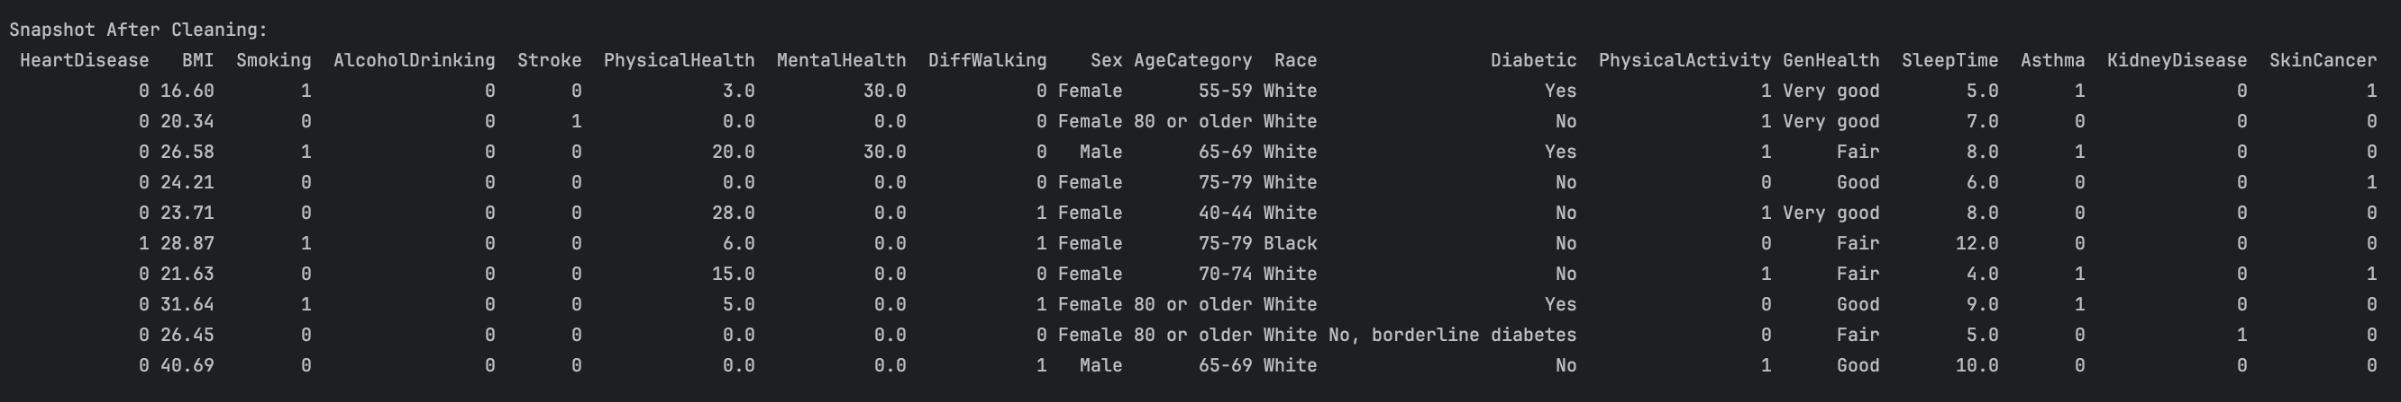
After Cleaning

Slide 6
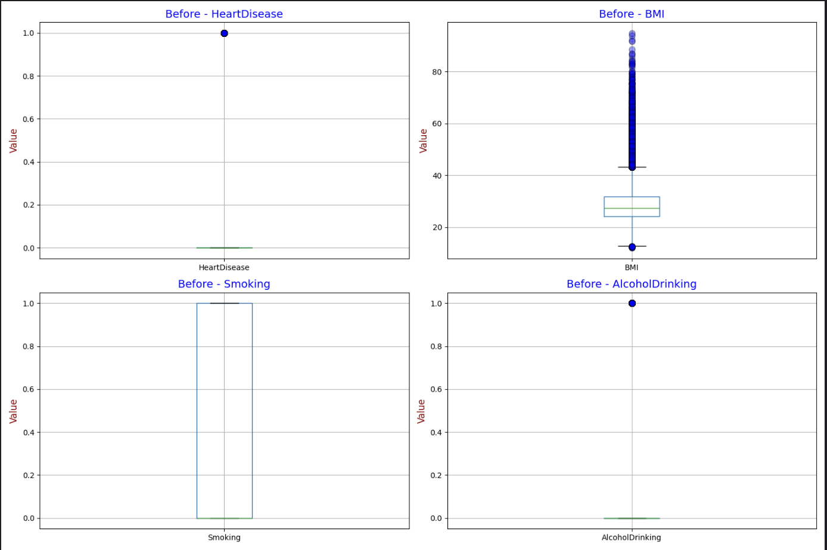
Outliers in Dataset

Slide 7
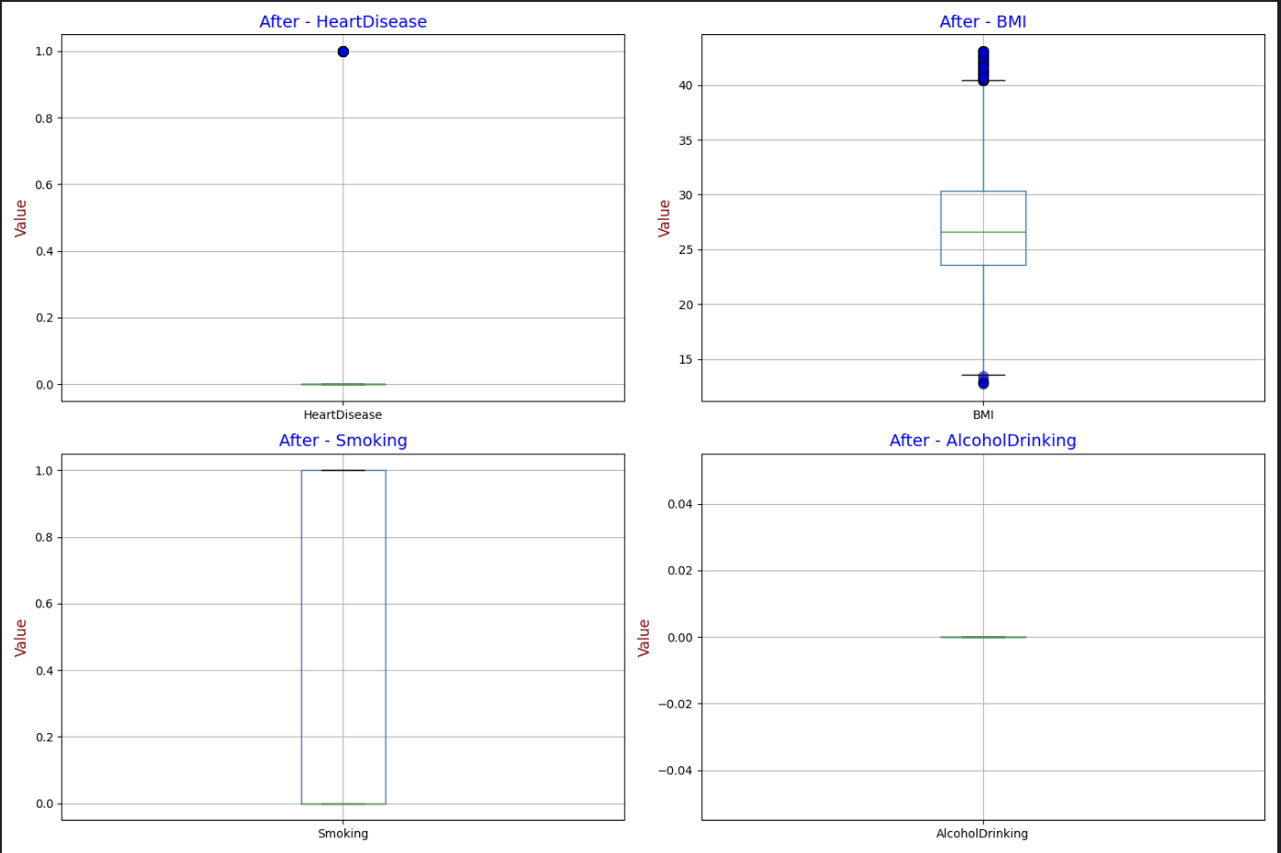
After Outlier Removal

Slide 8
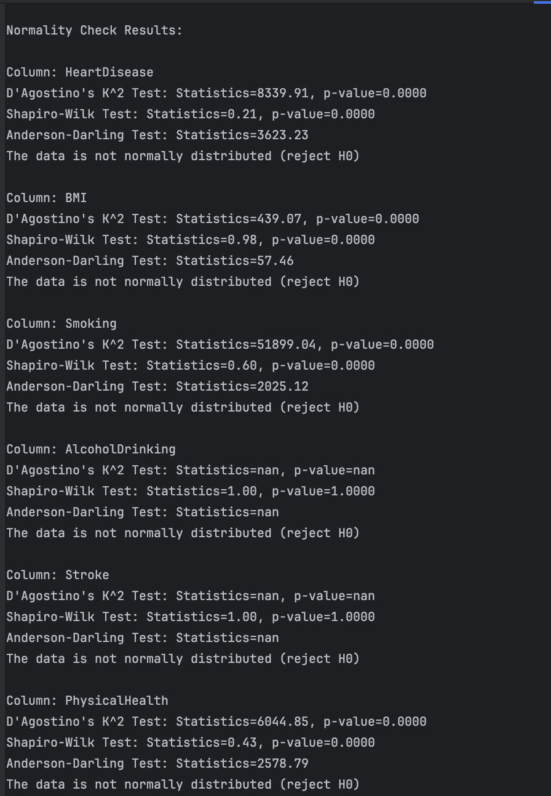
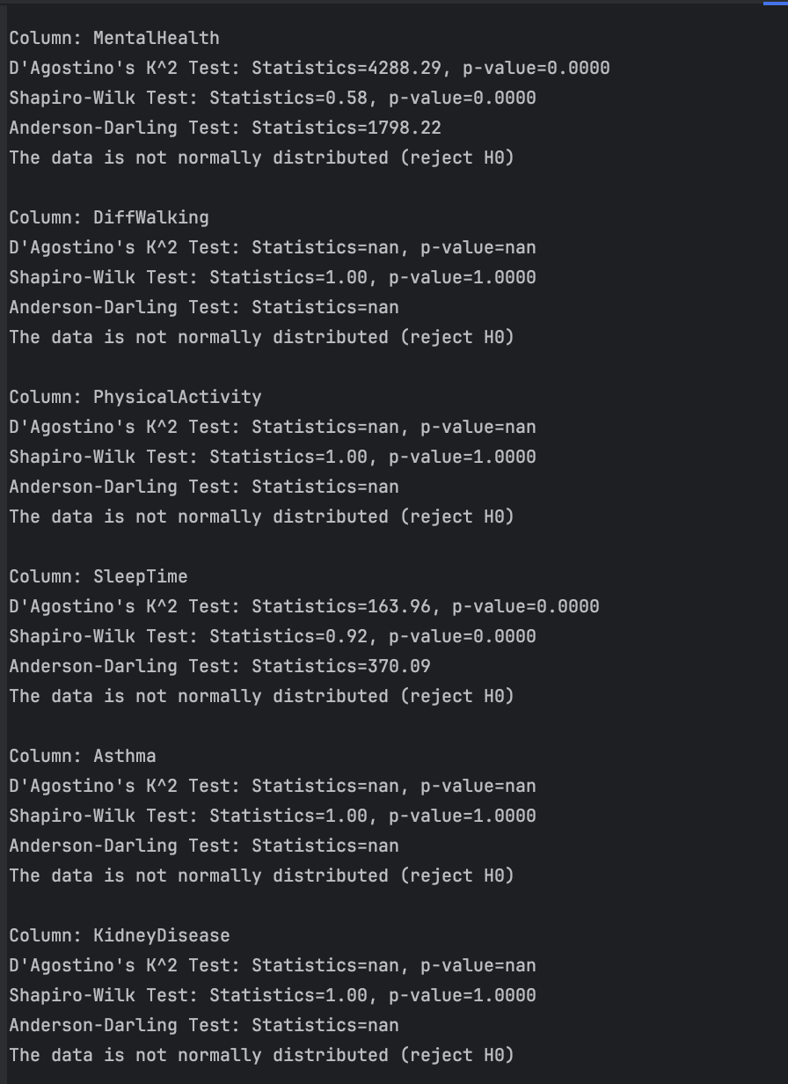
Normality Test Using D’Agostino’s K², Shapiro-Wilk, and Anderson-Darling tests
Statistical Tests Used: D’Agostino’s K², Shapiro-Wilk, and Anderson-Darling tests were applied to all numeric variables.
Key Findings: Majority of health-related features including BMI, Sleep Time, Physical Health, and Mental Health failed all normality tests with p-values far below 0.05, indicating strong evidence against normality.
Insight: The dataset contains non-normally distributed variables, which makes data transformation essential before using statistical techniques like PCA, Z-score normalization, or parametric analysis.

Slide 9
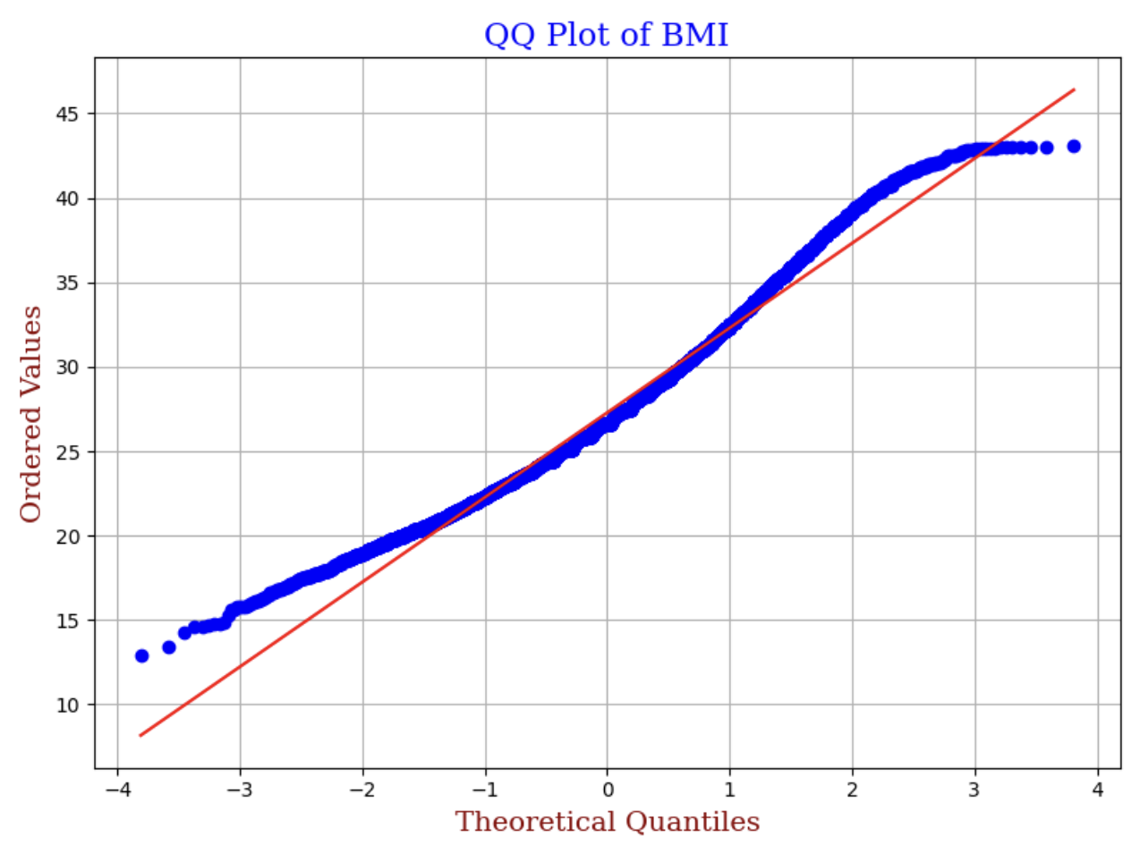
Visualizing Normality: QQ Plot
Quantile-Quantile (QQ) plots visually assess whether a variable's distribution approximates normality by plotting sample quantiles against theoretical normal quantiles.
Variables such as BMI and Sleep Time deviate notably from the reference diagonal line, indicating that they do not follow a normal distribution.
This deviation justifies the application of data transformations (e.g., log, Box-Cox) before techniques like PCA or linear regression, which assume normality for optimal performance.

Slide 10
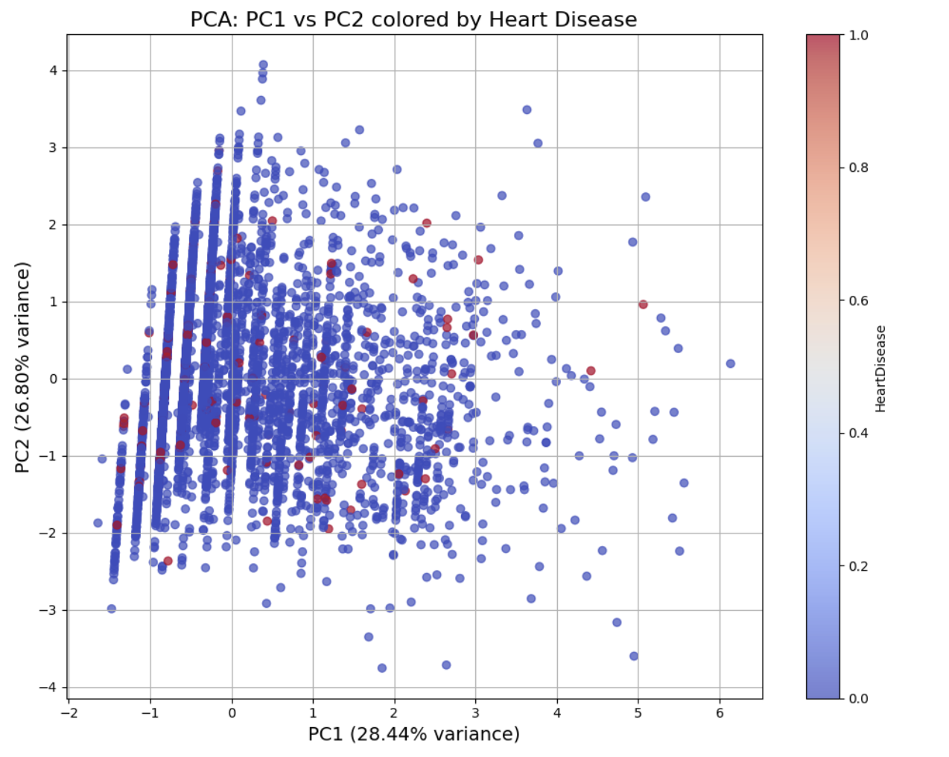
Principal Component Analysis (PCA)
Purpose of PCA: Principal Component Analysis (PCA) was applied to reduce dimensionality and multicollinearity among numeric features. It transforms the dataset into uncorrelated components while preserving as much variance as possible.
Key Findings: The first two principal components (PC1 and PC2) capture a combined variance of ~55.24%. The PCA scatter plot shows visible clustering based on heart disease presence, suggesting underlying patterns in the data.
Insights for Modeling:
PCA helps simplify complex datasets and improves the efficiency of models like logistic regression or clustering.

Slide 11
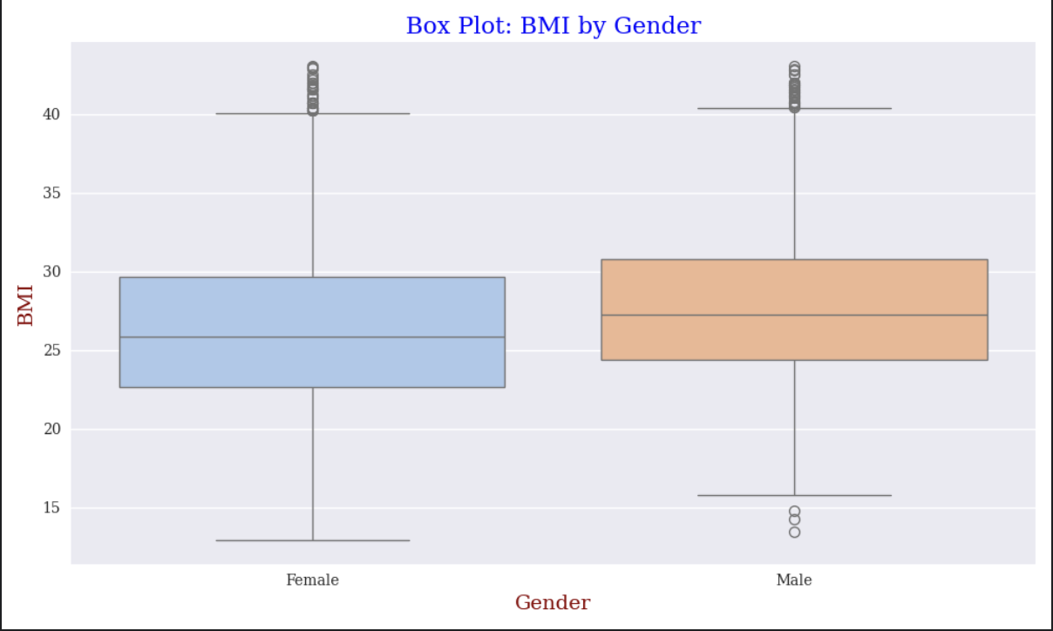
Gender-Based Differences in BMI
The median BMI for both males and females is closely aligned, but the distribution is slightly wider in males, suggesting more variability.
Female BMI values tend to be more concentrated with a narrower interquartile range (IQR), while males show a slightly higher upper whisker, indicating more cases with elevated BMI.
Both genders show BMI outliers, but males have more upper outliers, which may be linked to lifestyle or comorbidities like heart disease.

Slide 12
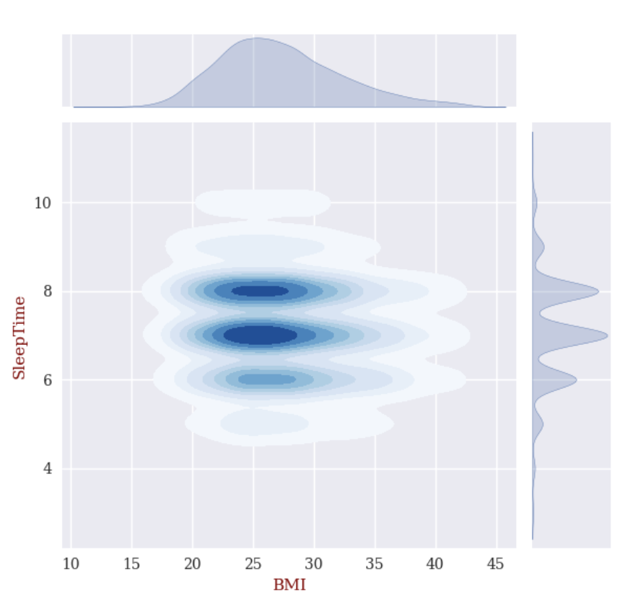
Joint KDE Plot: Sleep Time vs BMI
This joint KDE plot visualizes the distribution overlap between BMI and Sleep Time.
The densest region (darkest blue) shows most individuals cluster around 7–8 hours of sleep and BMI of 24–28, indicating a relatively healthy lifestyle zone.
High-density cluster in the center suggests a strong association between moderate sleep and healthy BMI.
Spread on both axes shows that both insufficient and excessive sleep can correspond with higher or lower BMI values.

Slide 13
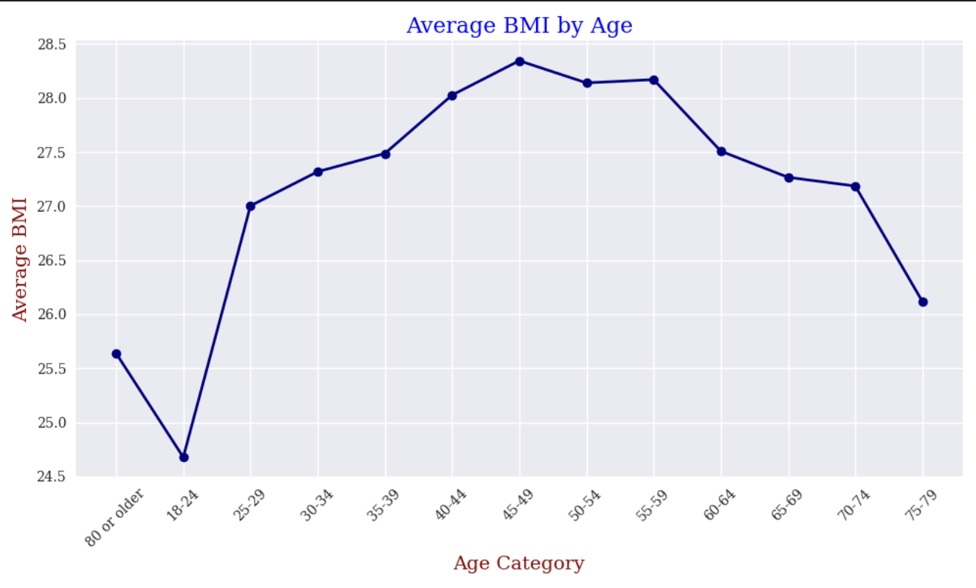
Line Plot – Average BMI Across Age Categories
BMI increases steadily from age 18–24 through middle age (45–54), peaking around 45–49 with an average BMI of nearly 28.4.
The youngest group (18–24) has the lowest average BMI, whereas middle-aged adults (40–59) exhibit the highest obesity risk.
The upward BMI trend through adulthood highlights the need for early lifestyle interventions to curb weight gain during high-risk age periods.
The decline in later age may be due to loss of muscle mass or changing dietary and physical activity habits.

Slide 14
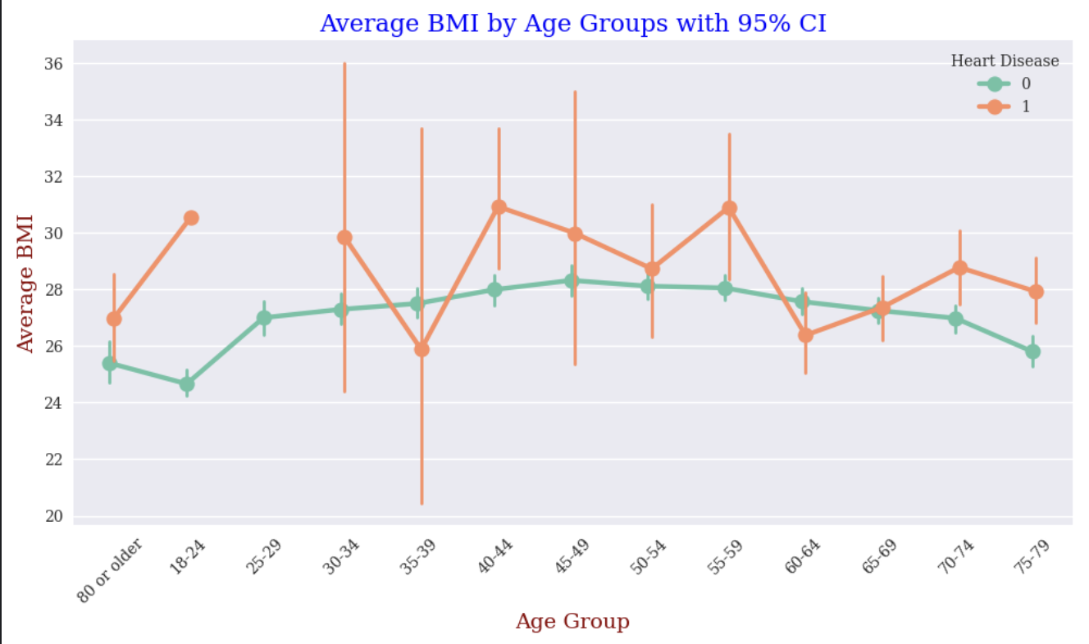
BMI Differences by Age and Heart Disease Status
This point plot visualizes how average BMI varies across age groups, split by heart disease status.
Individuals with heart disease generally show higher average BMI across multiple age groups, indicating obesity as a consistent risk factor.
Some age groups (30–44, 55–59) show especially pronounced differences, reinforcing the need for targeted intervention.
This chart combines trend insight + statistical reliability, making it a powerful addition to our health risk assessment.

Slide 15
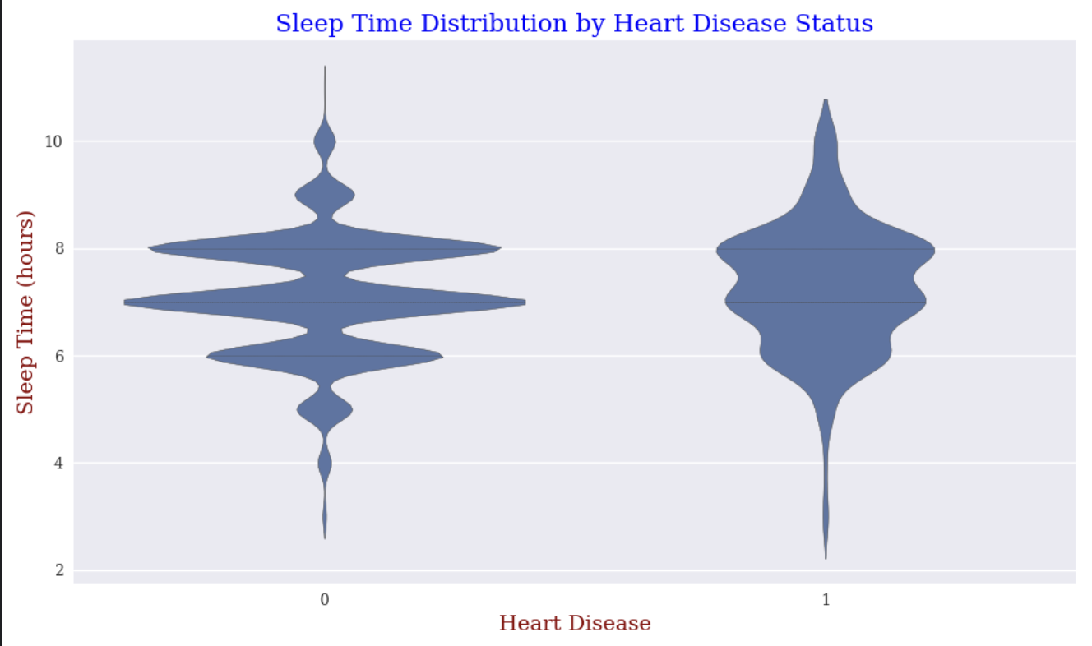
Impact of Sleep Patterns on Heart Health
This violin plot compares the distribution of sleep duration between individuals with and without heart disease.
People without heart disease tend to sleep slightly longer and show a more balanced distribution, mostly clustering around 7–8 hours.
On the other hand, those with heart disease exhibit a slightly shorter and tighter range, indicating a possible correlation between reduced or irregular sleep and heart disease risk.
The violin shape visually highlights the density and variability, offering more detail than boxplots alone.

Slide 16
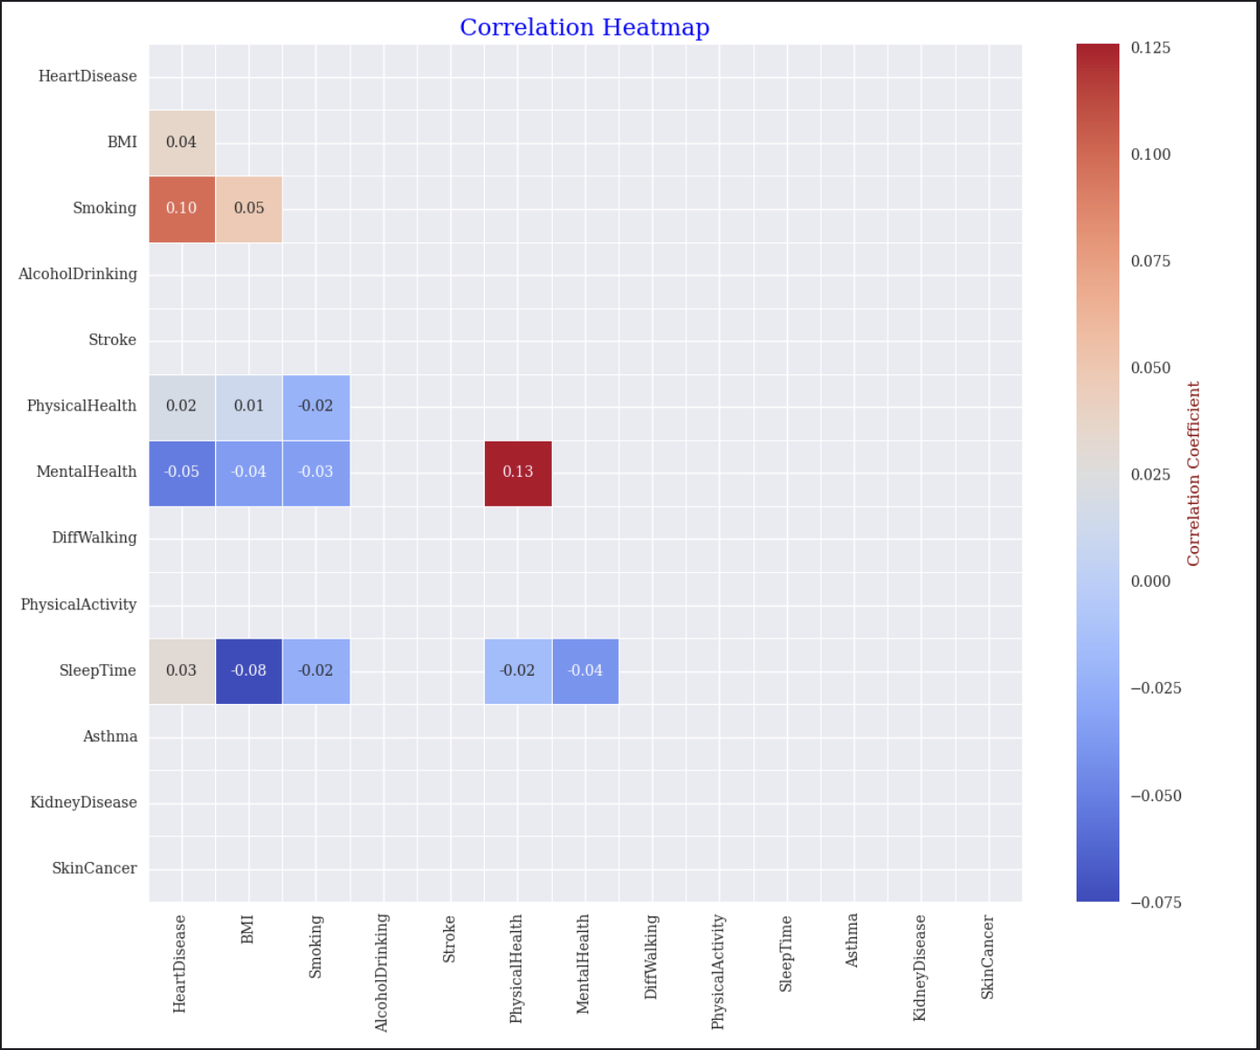
Correlation Heatmap of Numerical Columns
Correlation Analysis of Selected Variables
Heart Disease and Smoking (0.10): Shows a slight positive correlation, suggesting that smokers might have a marginally higher risk of heart disease in this dataset.
Heart Disease and BMI (0.04): Very weak correlation, indicating BMI alone is not a strong indicator of heart disease.
Heart Disease and Alcohol Drinking (0.05): Extremely low correlation, meaning alcohol consumption doesn’t strongly correlate with heart disease.
Mental Health and Physical Health (0.13): The highest correlation shown — indicates that people with poor physical health tend to also report more mentally unhealthy days.

Slide 17
Key Takeaways
Heart Disease is Not Just About Lifestyle Risks: While smoking and stroke show a clear association with heart disease, the data reveals that individuals with regular physical activity and no alcohol consumption can still be at risk highlighting that biological and genetic factors also play a significant role beyond visible lifestyle choices.
Sleep Patterns and BMI Matter: Violin and joint plots showed that reduced sleep time and higher BMI clusters are prevalent among individuals with heart disease. However, even normal BMI individuals aren't risk-free, emphasizing the importance of integrated health metrics in cardiovascular risk profiling.
Key Insight: Heart diseases is not about smoking or alcohol consumption – even physically active, non-drinkers are at a risk. Sleep patterns and BMI are subtle but crucial factors. Obesity consistently shows up across all high-age group.

Slide 18
THANK YOU Link for Dashboard: https://dashapp-605581485690.southamerica-west1.run.app/

